Slide 1
Story Telling –Case-Study-Airbnb-NYC
By Chand Pasha

Slide 2
Problem Statement
Problem background
Suppose that you are working as a data analyst at Airbnb. For the past few months, Airbnb has seen a major decline in revenue. Now that the restrictions have started lifting and people have started to travel more, Airbnb wants to make sure that it is fully prepared for this change.
The different leaders at Airbnb want to understand some important insights based on various attributes in the dataset so as to increase the revenue such as -
Which type of hosts to acquire more and where?
The categorisation of customers based on their preferences.
What are the neighbourhoods they need to target?
What is the pricing ranges preferred by customers?
The various kinds of properties that exist w.r.t. customer preferences.
Adjustments in the existing properties to make it more customer-oriented.
What are the most popular localities and properties in New York currently?
How to get unpopular properties more traction? and so on...

Slide 3
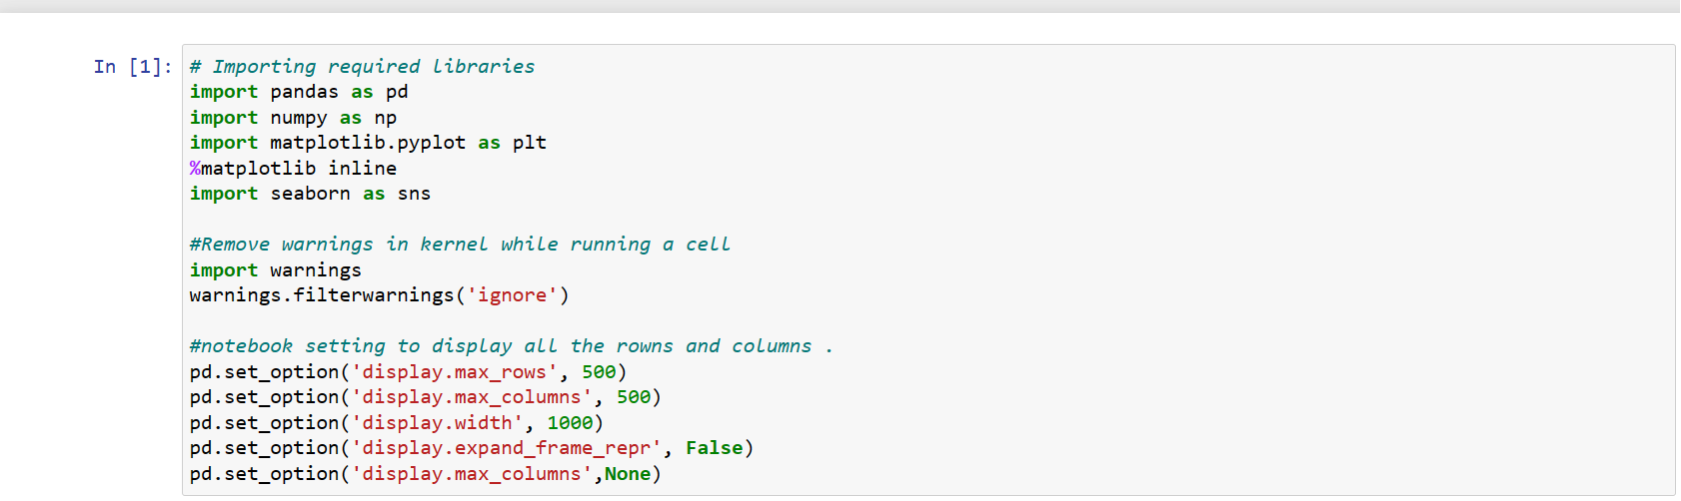
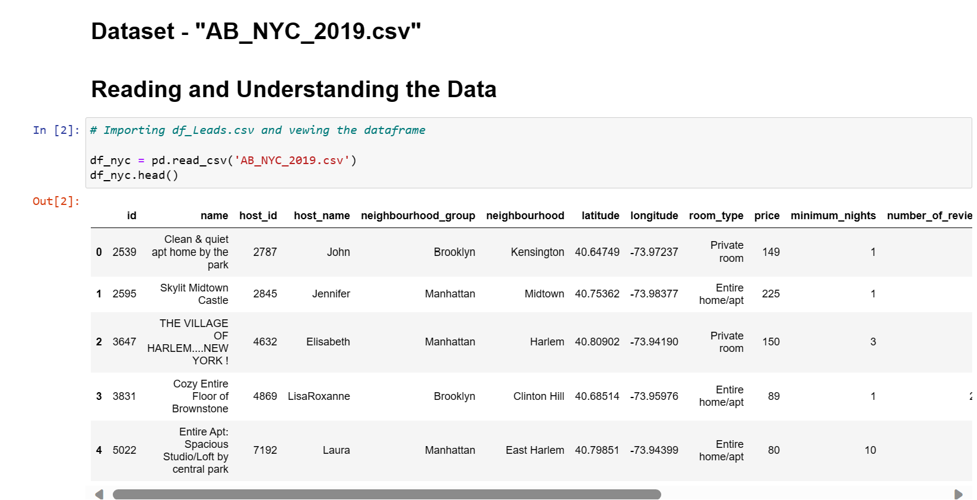

Slide 4
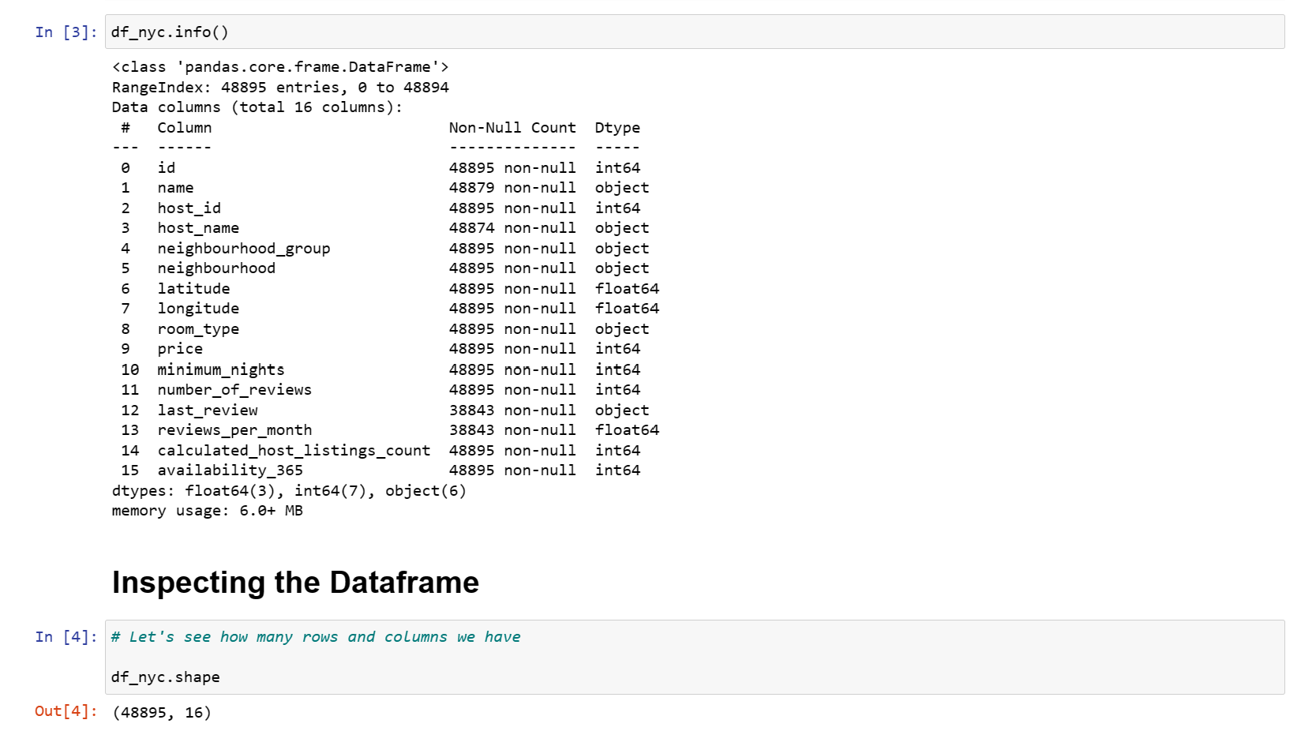
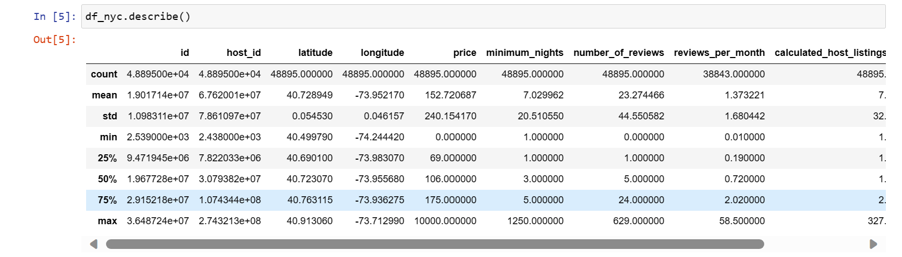

Slide 5
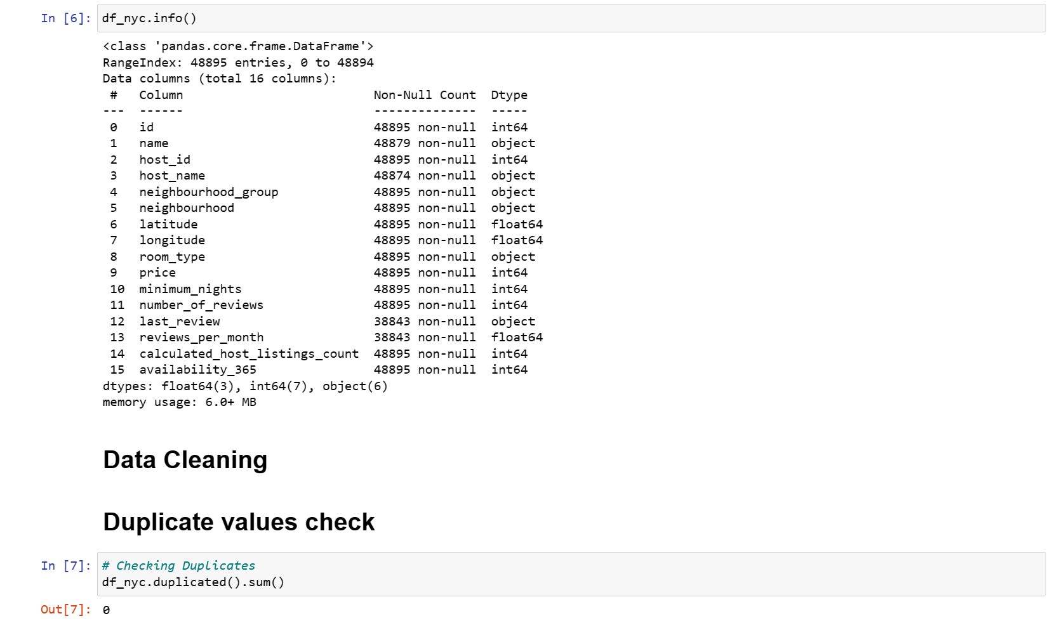

Slide 6
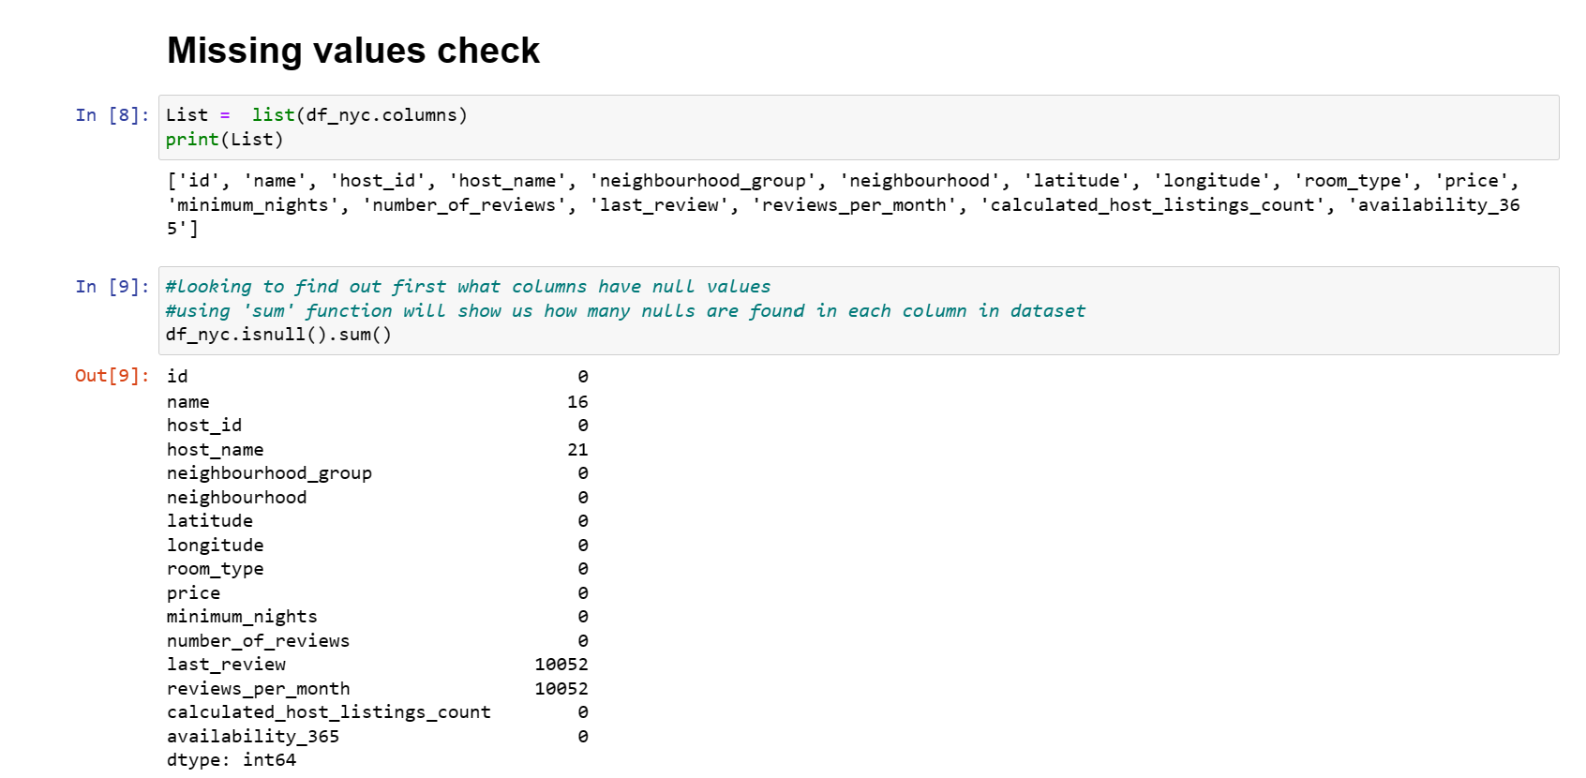

Slide 7
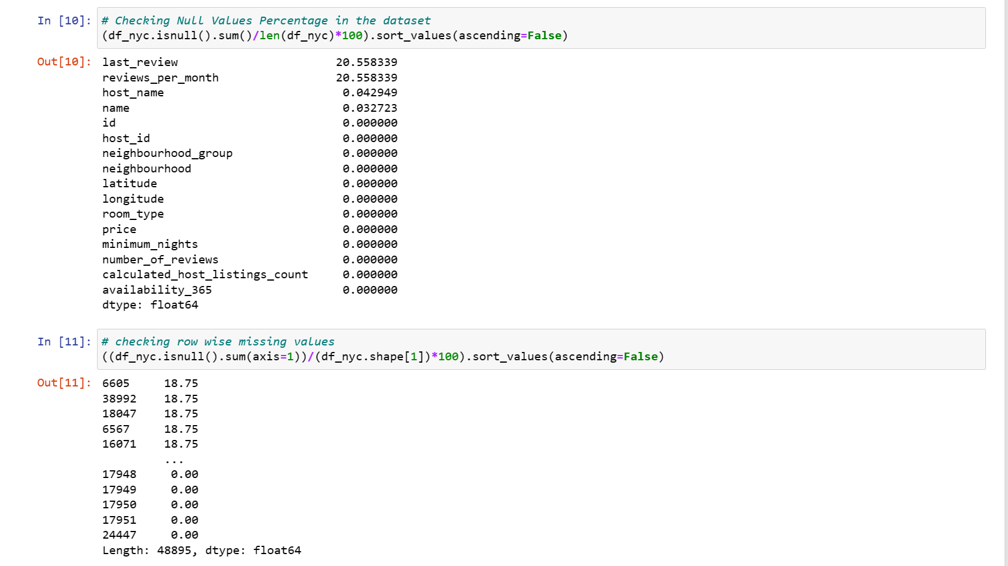
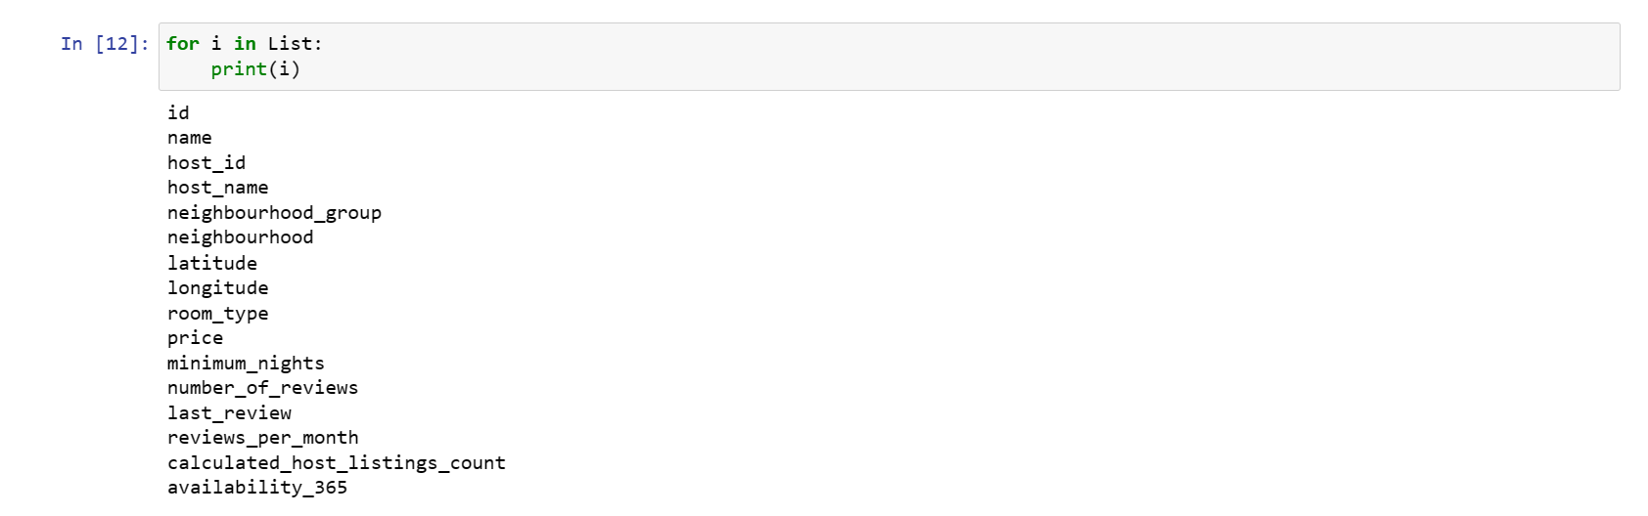

Slide 8
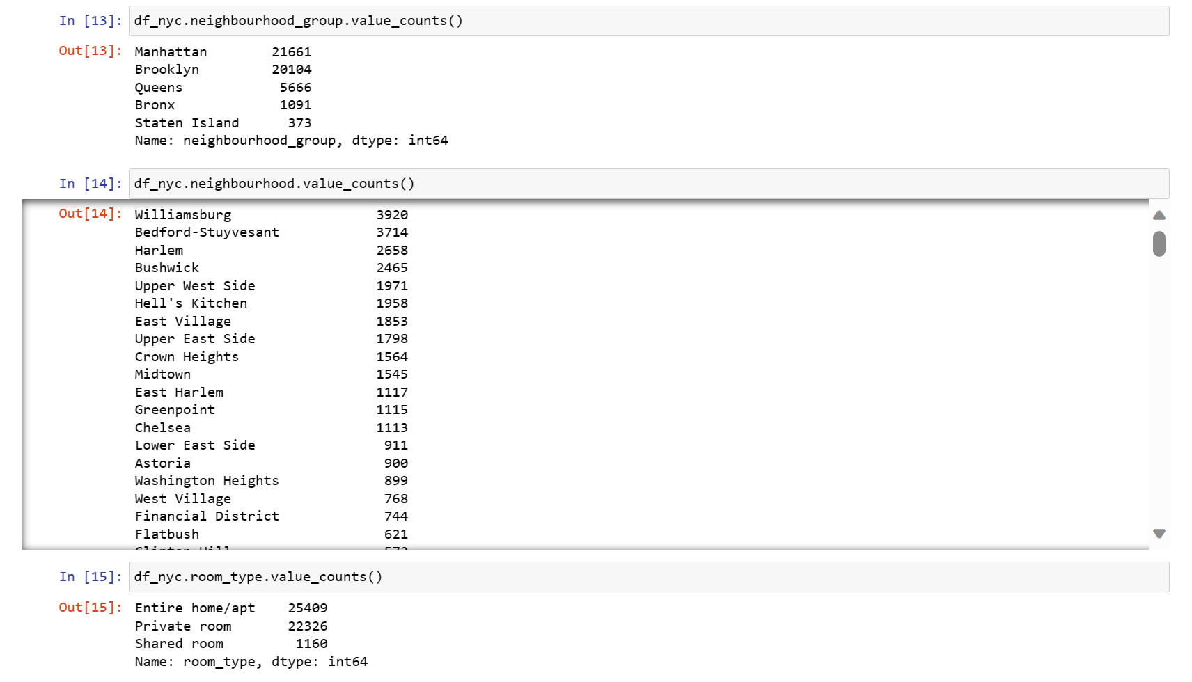

Slide 9
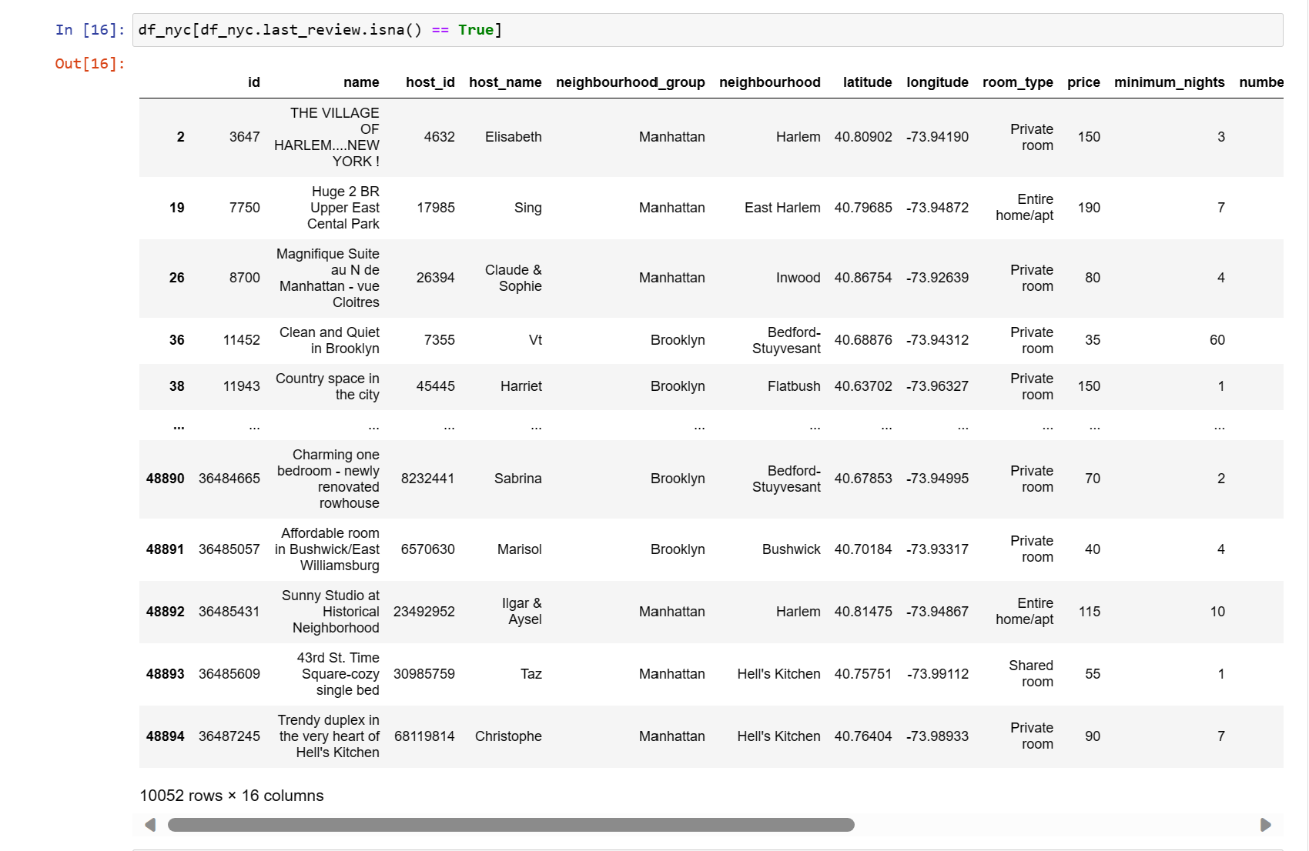

Slide 10
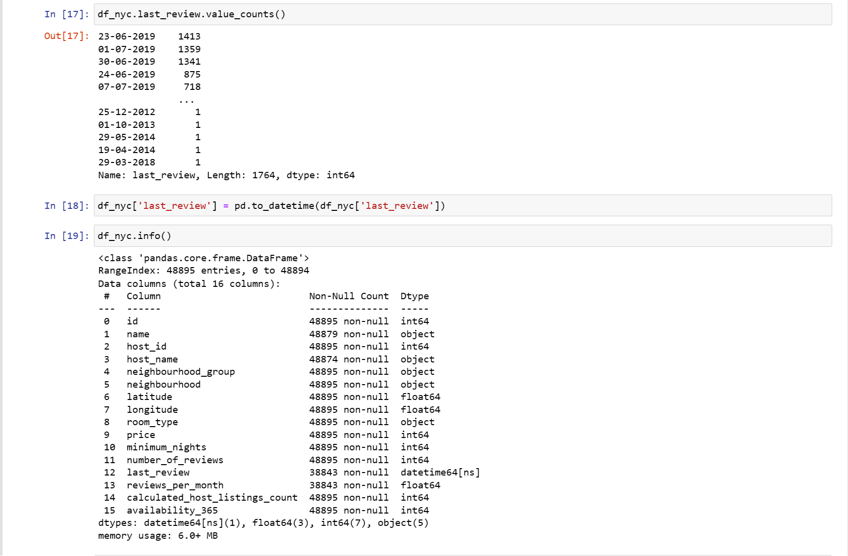

Slide 11
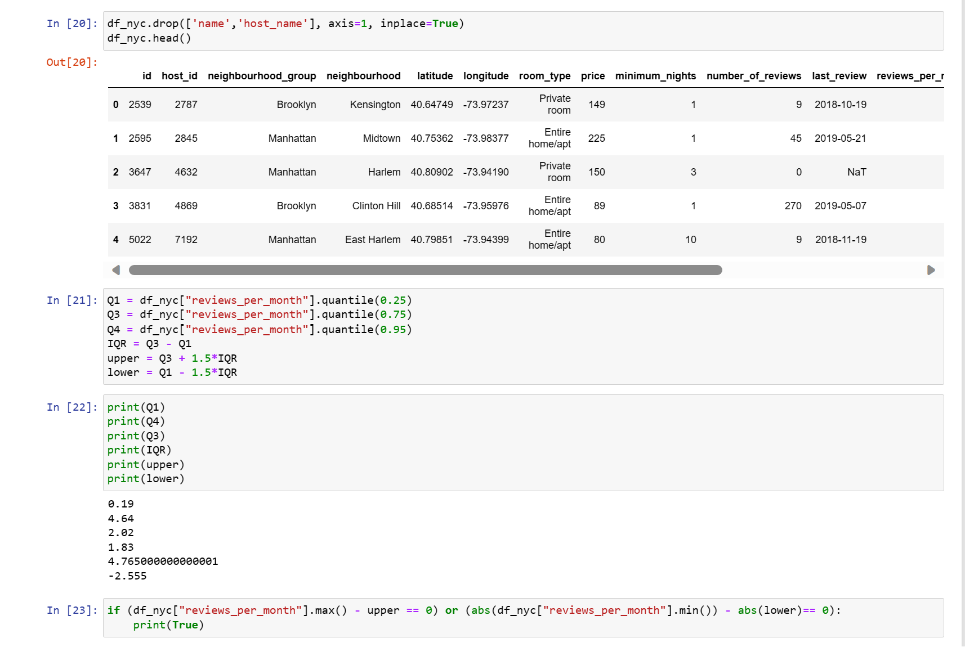

Slide 12
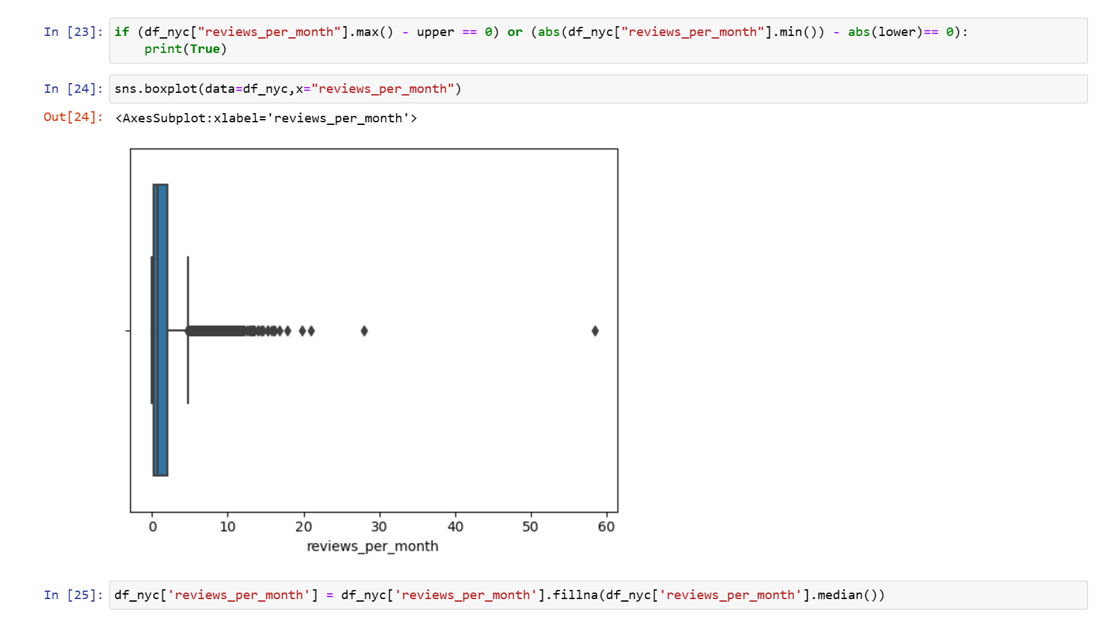

Slide 13
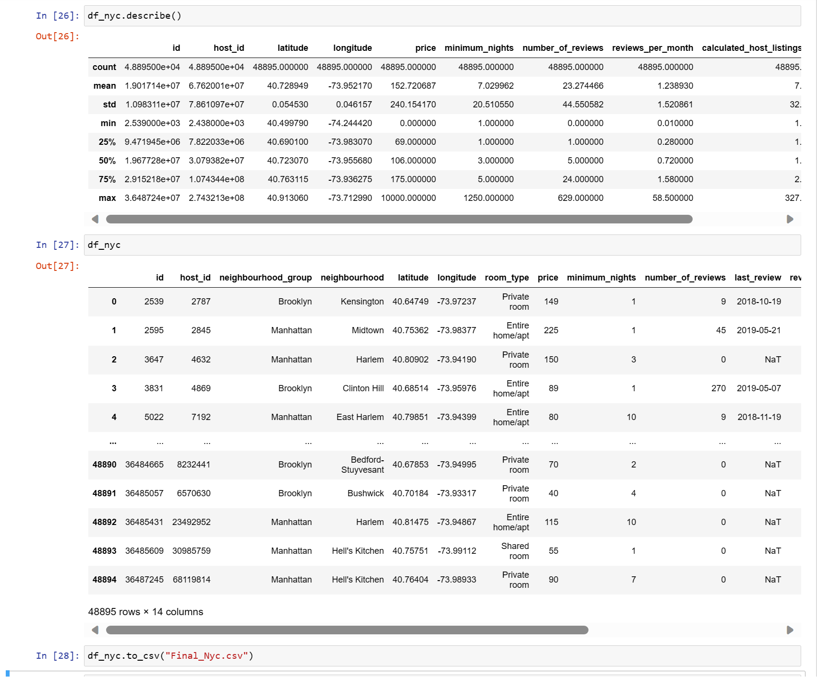

Slide 14
Thank you

